Slide 1
FloodLAMP QuickColorTM Covid-19
Training Course
STORYBOARD
Notes:
James, I created a copy and am working in here: https://docs.google.com/presentation/d/1BIjyjVBHKwJ4ALeNjHQt1TyhHf3kex_o5Zm_5yrTSRg/edit?usp=sharing

Slide 2
Moodle Course
Send learner link to self-enroll
Enrollment, completion, activity, etc data collection
FloodLAMP Staff reviews video
Self assess via Moodle Quiz
FloodLAMP Staff submits checklist on review of video
Notify FL Staff
Pass
EdPuzzle Interactive video w/ questions
Create 1X Inactivation Solution
EdPuzzle Interactive video w/ questions
Create Reaction Mix
Solution
EdPuzzle Interactive video w/ questions
Inactivation of Samples
EdPuzzle Interactive video w/ questions
Amplification
Run
EdPuzzle
Interactive screencast w/ questions
Review Amp Run Sheet
Submit self recorded full run to Moodle Assignment
Learner logs into Moodle
Pass
Fail
Fail
Certificate
!!!
Retake the course

Slide 3
Video List for Phase1
Overview
Safety and Contamination
Prep 1X ISS
Prep Rxn Mix
Inactivation
Amplification (assay run)
App and Resulting
Dispenser
Moodle Course
Send learner link to self-enroll
Enrollment, completion, activity, etc data collection
Take Moodle Quiz
(closed book)
Self Grade
(logged in moodle)
Request on-site
Practice and cert
FloodLAMP Staff reviews video
Review
Quiz w Answers (moodle doc)
Pass
Record Run
On site
FloodLAMP Staff submits checklist on review of video
Triggers FL Staff notification
Self Grade
(logged in moodle)
EdPuzzle Interactive video w/ questions
Create 1X Inactivation Solution
EdPuzzle Interactive video w/ questions
Create Reaction Mix
Solution
EdPuzzle Interactive video w/ questions
Inactivation of Samples
EdPuzzle Interactive video w/ questions
Amplification
Run
EdPuzzle
Interactive screencast w/ questions
Review Amp Run Sheet
Submit self recorded full run to Moodle Assignment
Learner logs into Moodle
Fail
Pass
Fail
Pass
Fail
Certificate
!!!
Review Selected Videos

Slide 4
Module 1 - The Basics

Slide 5
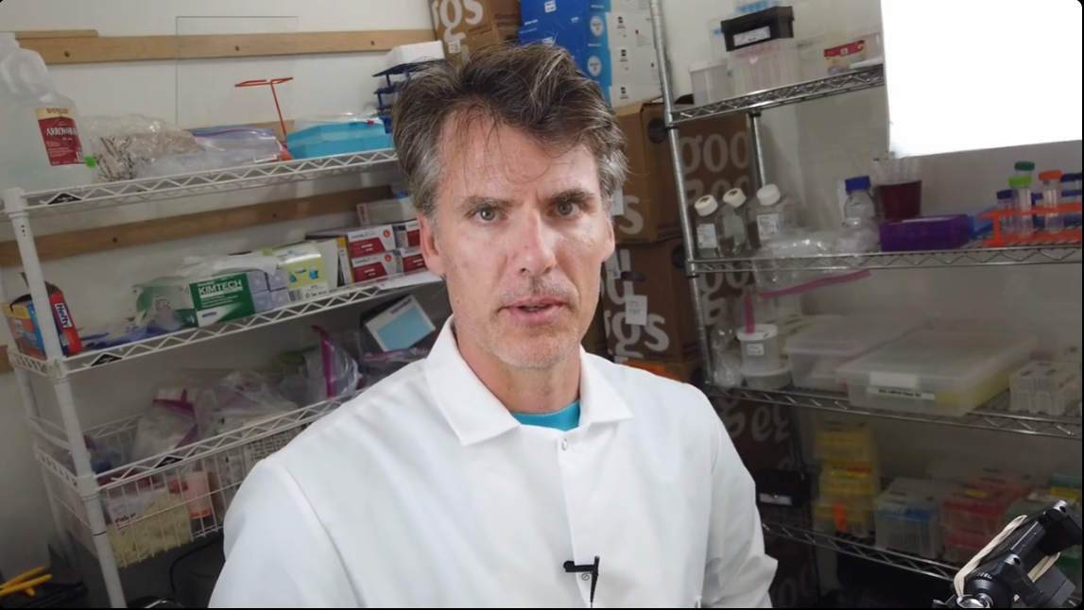
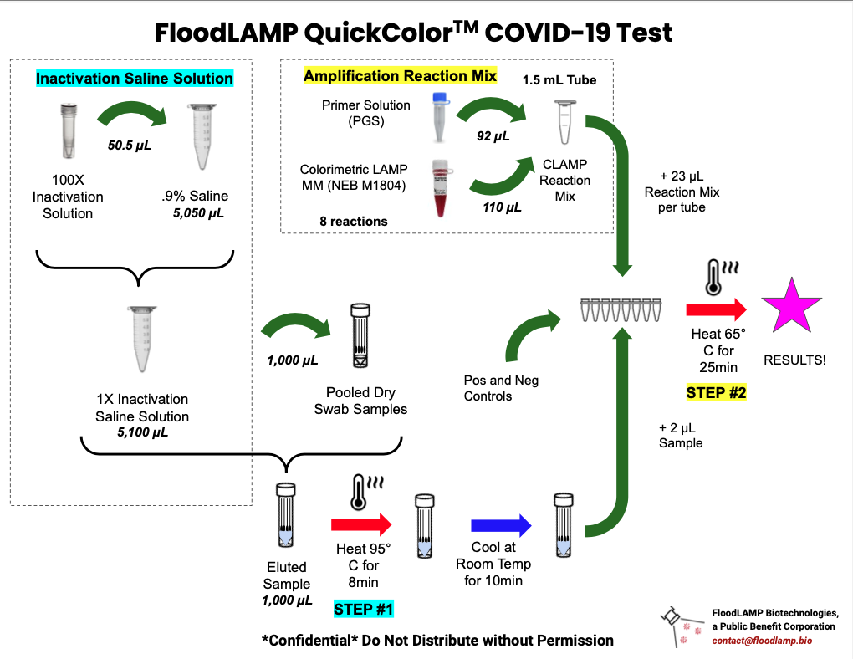
Start Here: Video 1.01
Big picture:
FloodLAMP’s purpose is to “unlock and scale” molecular testing, during COVID pandemic and also to improve health care moving forward.
The goal of these modules:
Prepare someone who has basic pipetting skills to run the testing process.
There are 15 videos that follow this one. All of them together will take about 2 hours (?) to complete.
Embedded Note: List the Videos that follow
Each video contains questions that about important steps of the process. These steps are what will be checked during the both the quiz and the video review of your certification run. Please pay close attention to these steps and questions and make sure you understand them.
You’ll be able to review the videos and the summary [what are we calling the notion version of the quiz with answers?] as many times as you want and use the questions to test yourself and build your confidence.
Embedded Question: I will be able to watch the videos over and over, and use the questions to build confidence.
True/False
(Continued)
There are two top concerns when you are running this process. Safety and contamination. Continue to the next video to learn about how to best address those concerns.
NEED new introductory video to set the stage
Interactive Video in EdPuzzle
Randy to Camera
1.5 minutes

Slide 6
Assumptions: Video 1.02
We have some assumptions about the learner’s previous experience and knowledge.
Answer the following questions to ensure you feel confident about your own experience and knowledge
Embedded Question: (Feedback can be the same for all, they must be confident for all)
I am comfortable using a pipette to distribute different volumes of liquids (Likert? Yes/No?)
I can explain basic RNA/DNA contamination concerns in a lab environment (Likert? Yes/No?)
I know how to prevent most common contamination concerns (Likert? Yes/No?)
I understand and can mitigate most of the safety concerns in a reaction that has chemicals that might cause eye or skin irritation (Likert? Yes/No?)
(Randy to review and complete these)
NEED new video here to cite assumptions
Assumption 1
Assumption 2
Assumption 3
Assumption 4
Assumption 5
Assumption 6
Interactive Video in EdPuzzle
Randy to Camera
20 seconds

Slide 7
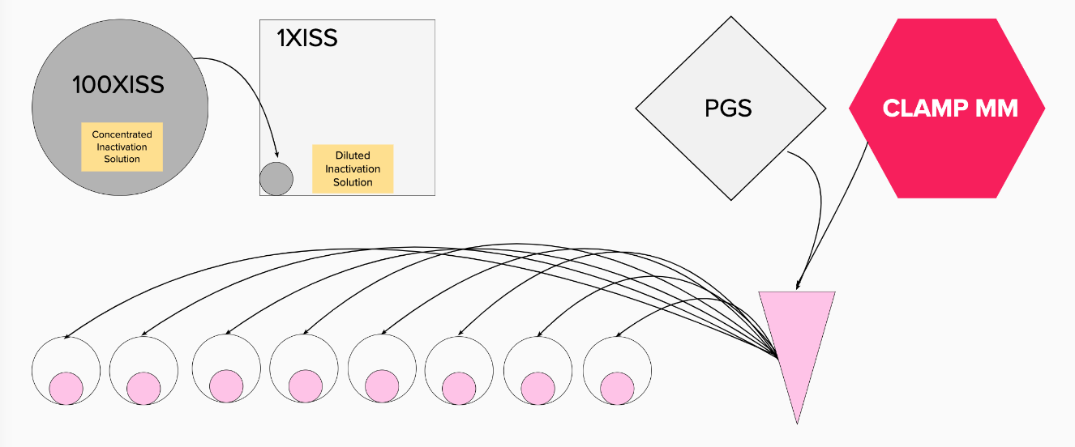
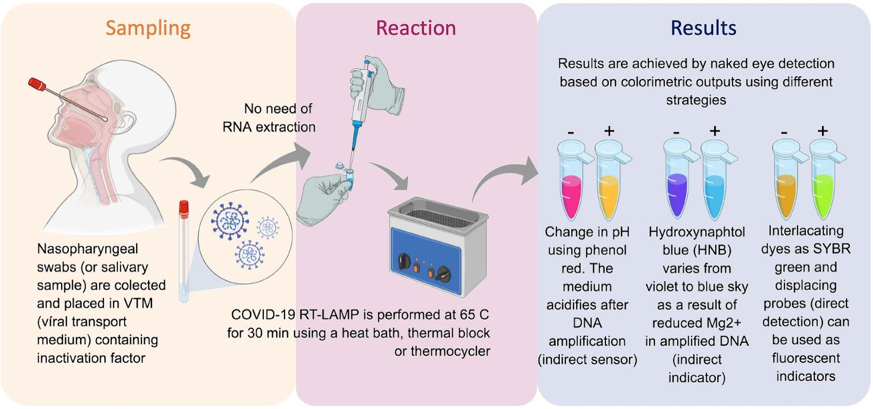
Overview of the Amplification Reaction Process: Video 1.03
This overview will not have all the details but it will get you oriented to the overall process.
You’ll have all the PPE on, and you’ll have a clean and prepared environment.
You’ll dilute the Inactivation Solution first as the diluted version can only last a day so you have to make it every day.
You’ll take samples and you’ll inactivate them in the solution on the heater.
You’ll combine the right amounts of the Primers (PGS) and the CLAMP MASTER MIX and 23ul of that will go into each reaction tube in the plate..
From the inactivated samples you’ll take 2ul of each one and add that to the 23ul of the PGS and Master Mix.
The plate will be heated and you’ll record the results.
Embedded Question: Based on this overview, how confident are you right now about your ability to run this?
Feedback for low confidence: Don’t worry! There is more training to come.
Feedback for high confidence: Fantastic. Review the rest of the videos and complete the questions to cement your confidence and hone your skills.
- Other possible “go-by” for a process graphic
”Go by” example graphics
”Go by” example graphics
Interactive Video in EdPuzzle
Voiceover of screencast graphic that builds with markup
2 minutes
Notes:
https://www.aphl.org/aboutAPHL/publications/Documents/WORK_BlueBook.pdf
We might be able to create our own questionnaire using this doc I found on the CDC website. See page 35.

Slide 8
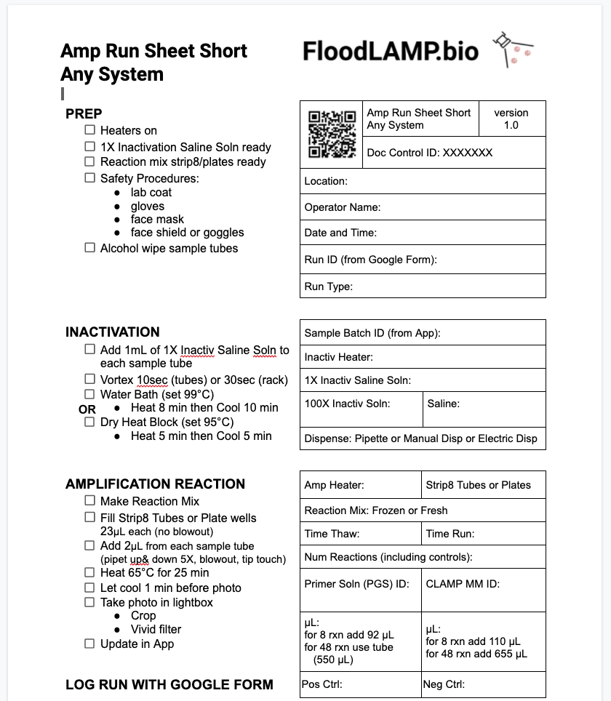
The Amp Run Sheet
Review the process for completing and the need for data recording, standards and compliance
Embedded Questions: TBD from Randy.
Short Amy Run - Any System
Long Amp Run - Mini System
Interactive Video in EdPuzzle
Voiceover screencast document w/ markup
2 minutes

Slide 9
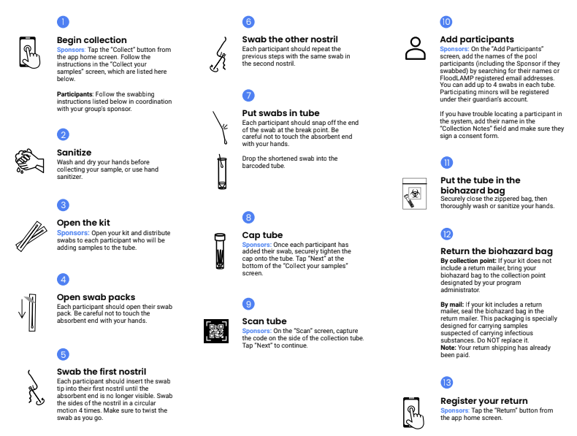
The Collection Process
Review the document
Embedded Questions: TBD from Randy.
Collection Kit PDF
Interactive Video in EdPuzzle
Voiceover screencast document w/ markup
2 minutes

Slide 10
Module 2 - Preparing for & Running the Reaction
Notes:
James, I created a copy and am working in here: https://docs.google.com/presentation/d/1BIjyjVBHKwJ4ALeNjHQt1TyhHf3kex_o5Zm_5yrTSRg/edit?usp=sharing

Slide 11
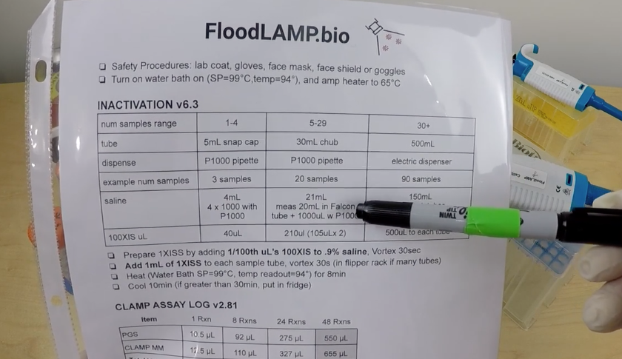
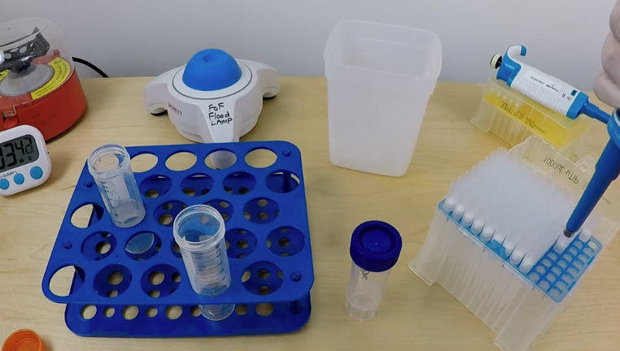
Making Diluted Inactivation Solution
Adding 5mL of Saline Solution to 50uL of the Inactivation Solution (100XSS)
Embedded Questions: TBD from Randy
For all tools, parts and pieces of the lab that we see for the first time, we introduce the same way: Note with text and voiceover explaining the item in less than 20 sec.
https://vimeo.com/602040532
Existing video of making inactivation solution
Interactive Video in EdPuzzle
1 minute

Slide 12
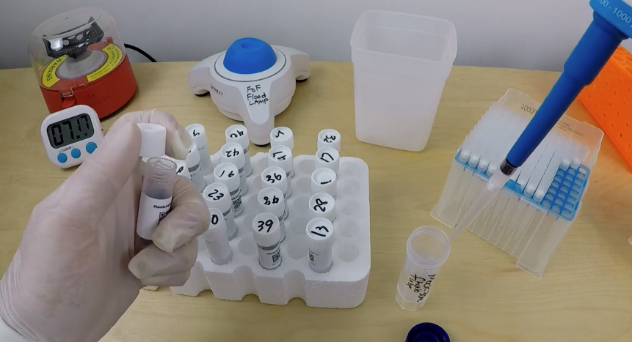
Inactivating the Samples
Adding 1mL of the 1XISS inactivation solution to each sample and heating them
Embedded Questions: TBD from Randy
https://vimeo.com/602040532 Around 6 minute mark
Existing video of inactivating samples
Interactive Video in EdPuzzle
4 minute

Slide 13
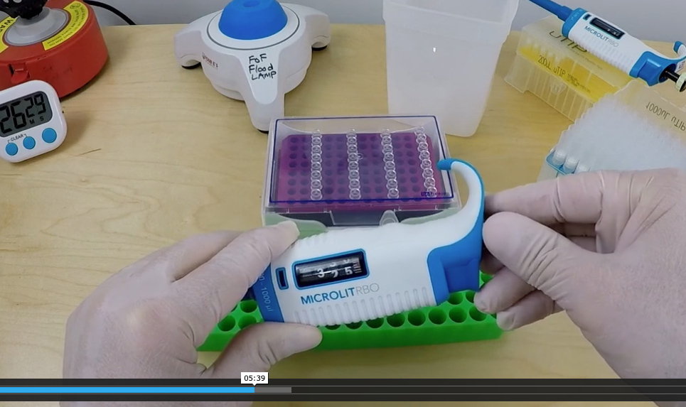
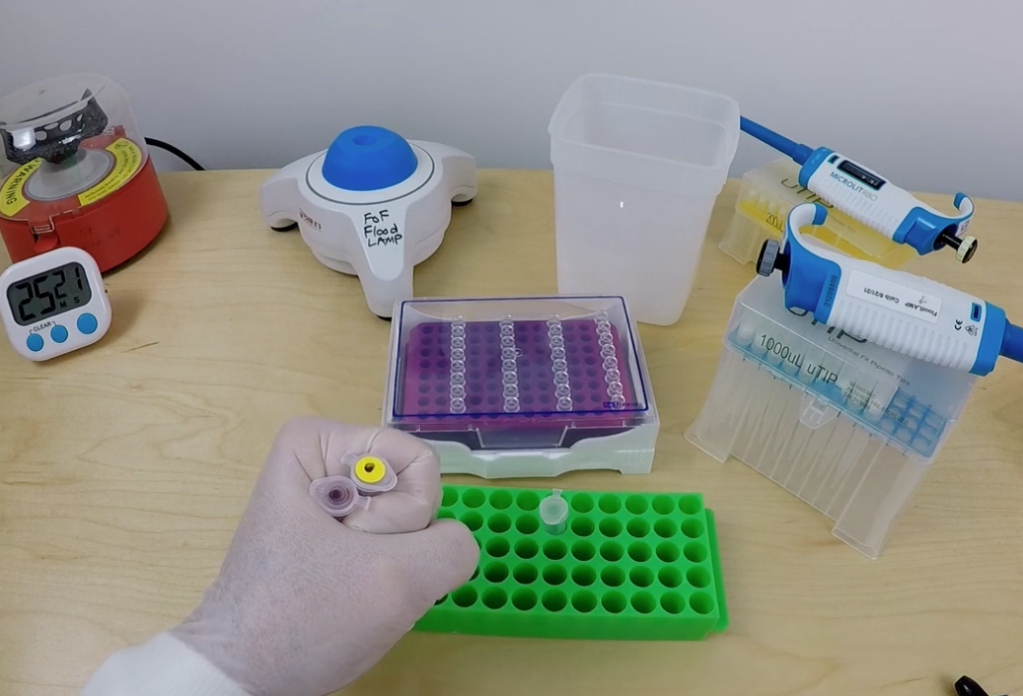
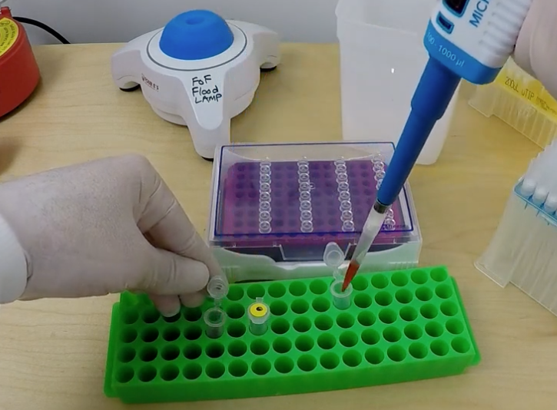
Making the Mix
Making the reaction mix for 48 reactions by combining PGS and CLAMP Master Mix
Add 655uL red MM to a PGS tube
Get CLAMP MM, PGS, P1000 and Tips
Set P1000 to 655 uL and dispense 655 uL of the red MM into the PGS tube dispense in middle and move tip to top to finish, blowout in liquid, tip touch
Embedded Question: What will happen if you dispense at the bottom of 1.5mL tube?
Nothing
Feedback: Think about the volume of the tip going into a nearly full tube.
Oops, it will overflow
Feedback: this is because the pipette tip is large for the tube size and displaces the liquid inside
Vortex for 10 seconds, and use the mini centrifuge with a ballast on the other side for about one second to bring all the solution to the bottom of the tube. You can make a ballast by filling a spare 1.5 mL snap cap tube with water and placing it on the polar opposite side of the centrifuge to balance it while rotating. This should drastically reduce vibration.
https://vimeo.com/602040683
Existing video of making the mix
Interactive Video in EdPuzzle
4 minutes

Slide 14
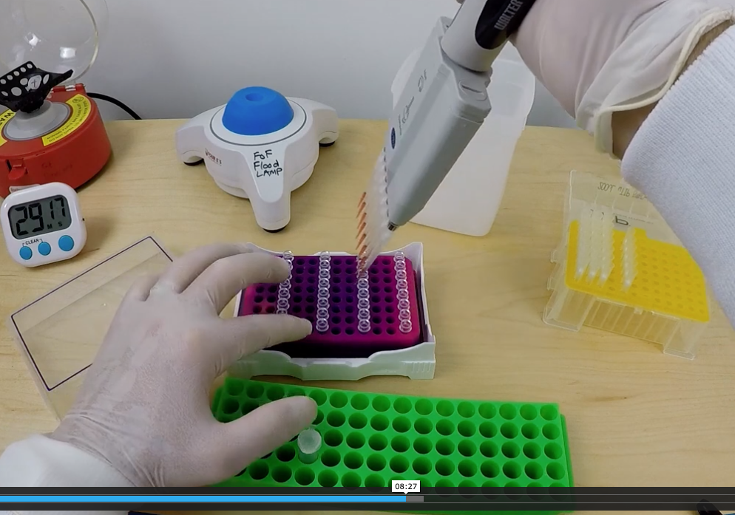
Distributing the mix to the reaction plate
Pipetting 23ul of the reaction mix to each reaction tube in the plate with the 8 point pipette
Embedded Questions: TBD from Randy
Existing video of distributing the mix to the reaction strips
Interactive Video in EdPuzzle
4 minute

Slide 15
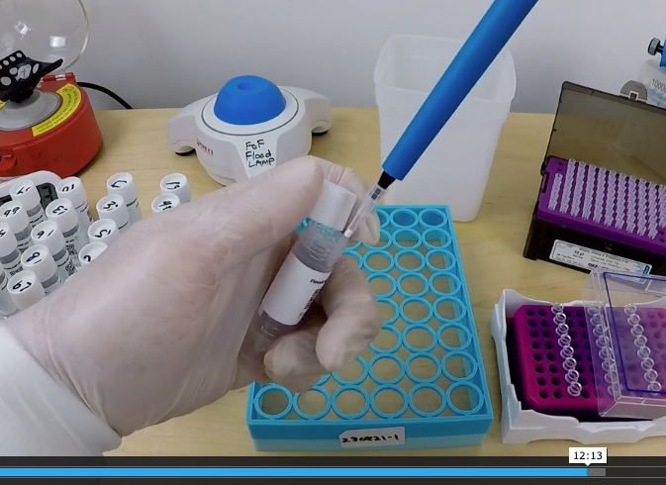
Adding 2uL of each sample to each reaction tube
Pipetting 2ul of each sample to each reaction tube in the plate with the 8 channel pipette
Embedded Questions: TBD from Randy
Existing video of distributing each sample to each reaction tube
Interactive Video in EdPuzzle
3 minute

Slide 16
Heating the samples with the reaction mix
Embedded Questions: TBD from Randy
NEED video of heating in the water bath
Interactive Video in EdPuzzle
2 minute

Slide 17
Documenting the Results
Embedded Questions: TBD from Randy
NEED new video of documenting the results with lookup rack etc.
Interactive Video in EdPuzzle
6 minutes

Slide 18
After this slide is only Reference or Archive materials

Slide 19
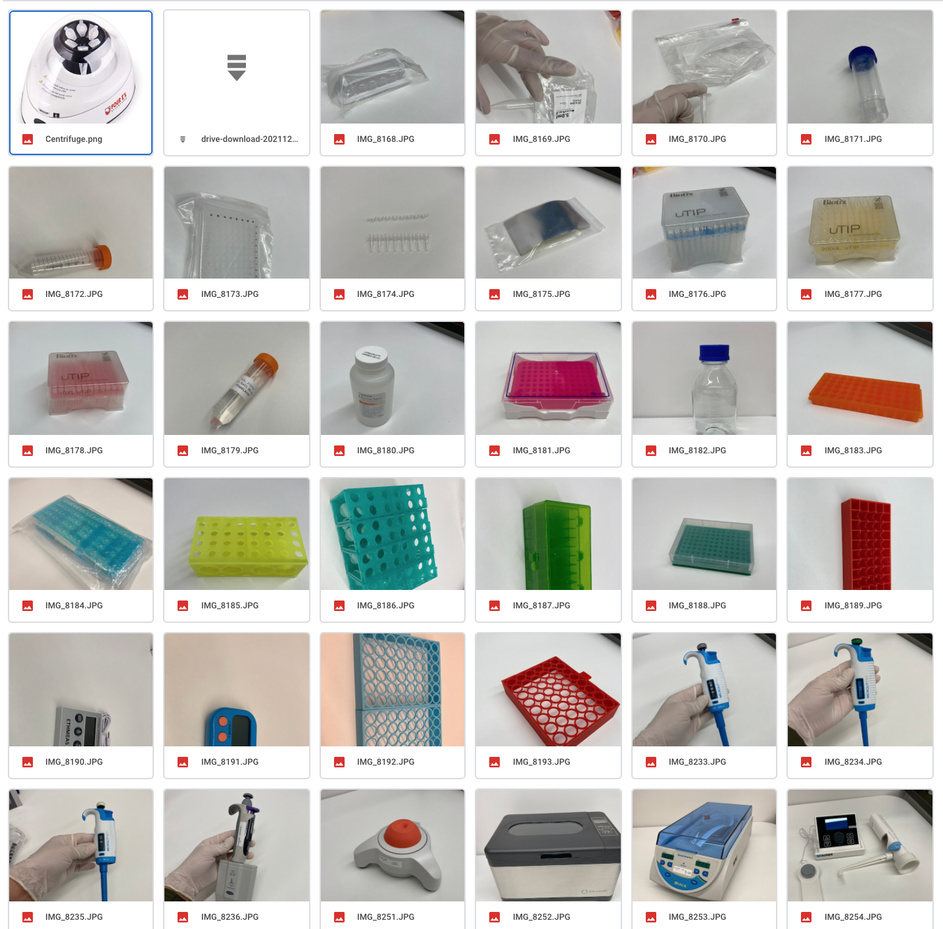
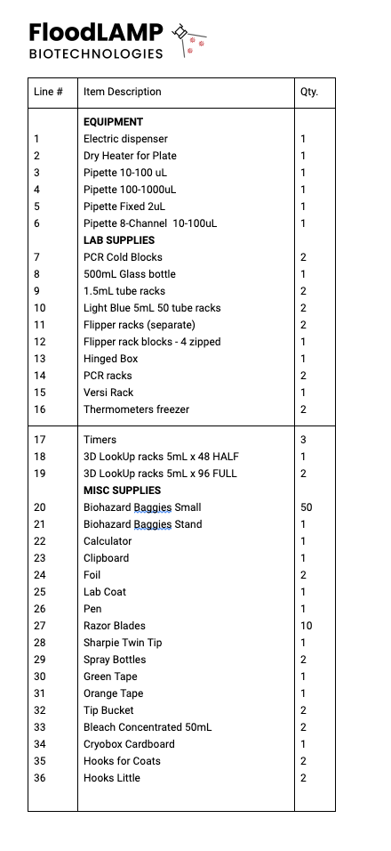
Phase 2 or FOR REFERENCE in PHASE 1
Standard Kit Parts Checklist
Show each part and learner confirms they have it
Picture with Description
Embedded Question: Do you have it? (Yes/No)
If No, some contact info or method to get it
Standard Kit Checklist
Interactive Video in EdPuzzle
Voiceover of screencast slides with pictures
3 minutes

Slide 20

Remediation If Needed:
Pipette Basics - Volumes
Include question: How many microliters equals 1 milliliter?

Slide 21
Pipette Basics - How to Use a Pipette

Slide 22
Pipette Basics- Pipetting Concerns

Slide 23
The Basics- Tube Prep

Slide 24
Pull questions from these
Pipette Step-by-Step from Scratch
What Ifs?

